Slide 1
ROCKET POP
A Game Pitch by Eric Noce

Slide 2
What is the high concept of this game?

Slide 3
What is the high concept of this game?
Rocket Pop mashes up three historically popular and easily recognizable genres; music, platforming, and action-adventure.
This entire game is presented in the third-person perspective.
Fairly simple gameplay when compared with other games in these areas

Slide 4
How does the game story go?

Slide 5
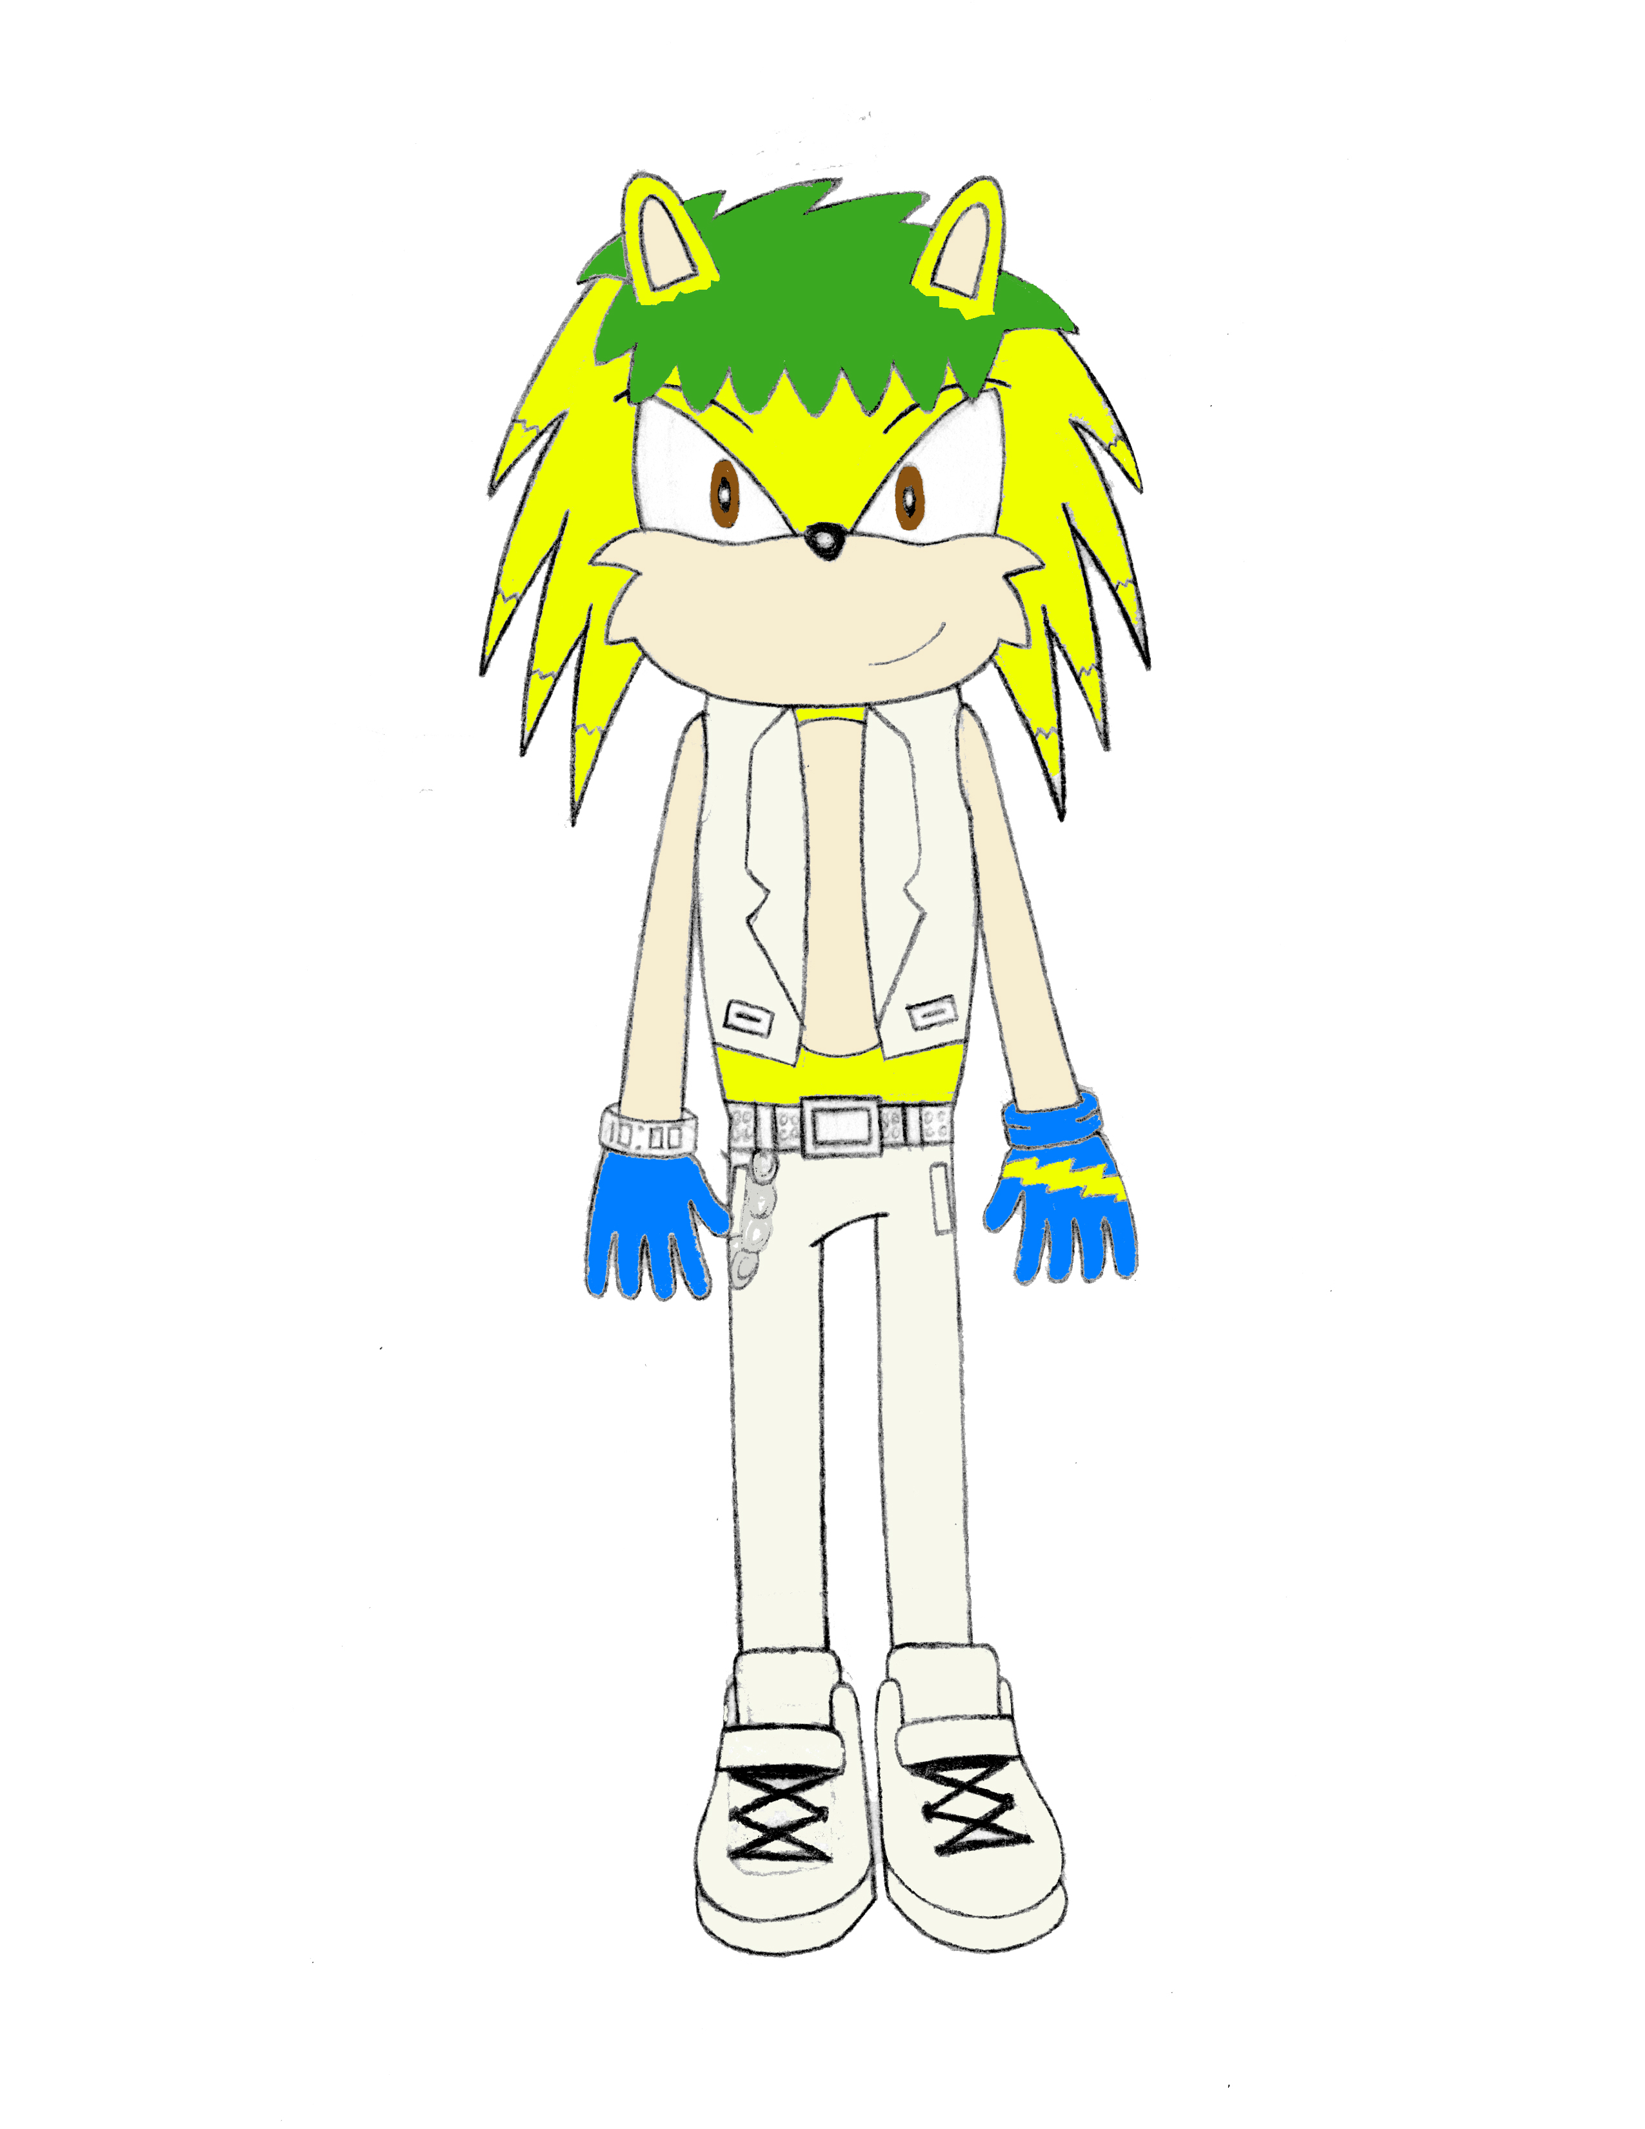
How does the game story go?
In a world where humans coexist with anthropomorphic animals, Michael Fleming is a famous porcupine pop star known for birthing a new, unique version of pop music known as “Rocket Pop.”
One day, a jealous, little-known recording artist named Mr. Drain starts stealing the voices of numerous world-famous celebrities, including Michael's girlfriend, fellow pop star Jocelyn.
The player controls Michael to help him rescue all of the stolen voices.

Slide 6
gameplay

Slide 7


Gameplay
The player controls Michael through Los Angeles, a hotbed for entertainment, and his home of Oak Land, in another dimension of Earth. The game alternates between the two worlds.
In 3D action game levels, Michael uses his voice and strong steps to combat and defeat hordes of Mr. Drain’s powerful, but sensitive, robots.
In rhythm game-style levels, he must gain the respect of his rivals to progress past them- here, icons of his face will slide down guideways and the player must press the appropriate buttons in time with the icons, which are perfectly synced with the music. Controls are like those in Superbeat: Xonic, except easier.
Defeating enemies and completing challenges can also earn him “Bass Points,” which he can spend on upgrades and new skills.
The level difficulty will increase as the player learns and gains experience

Slide 8
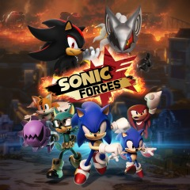
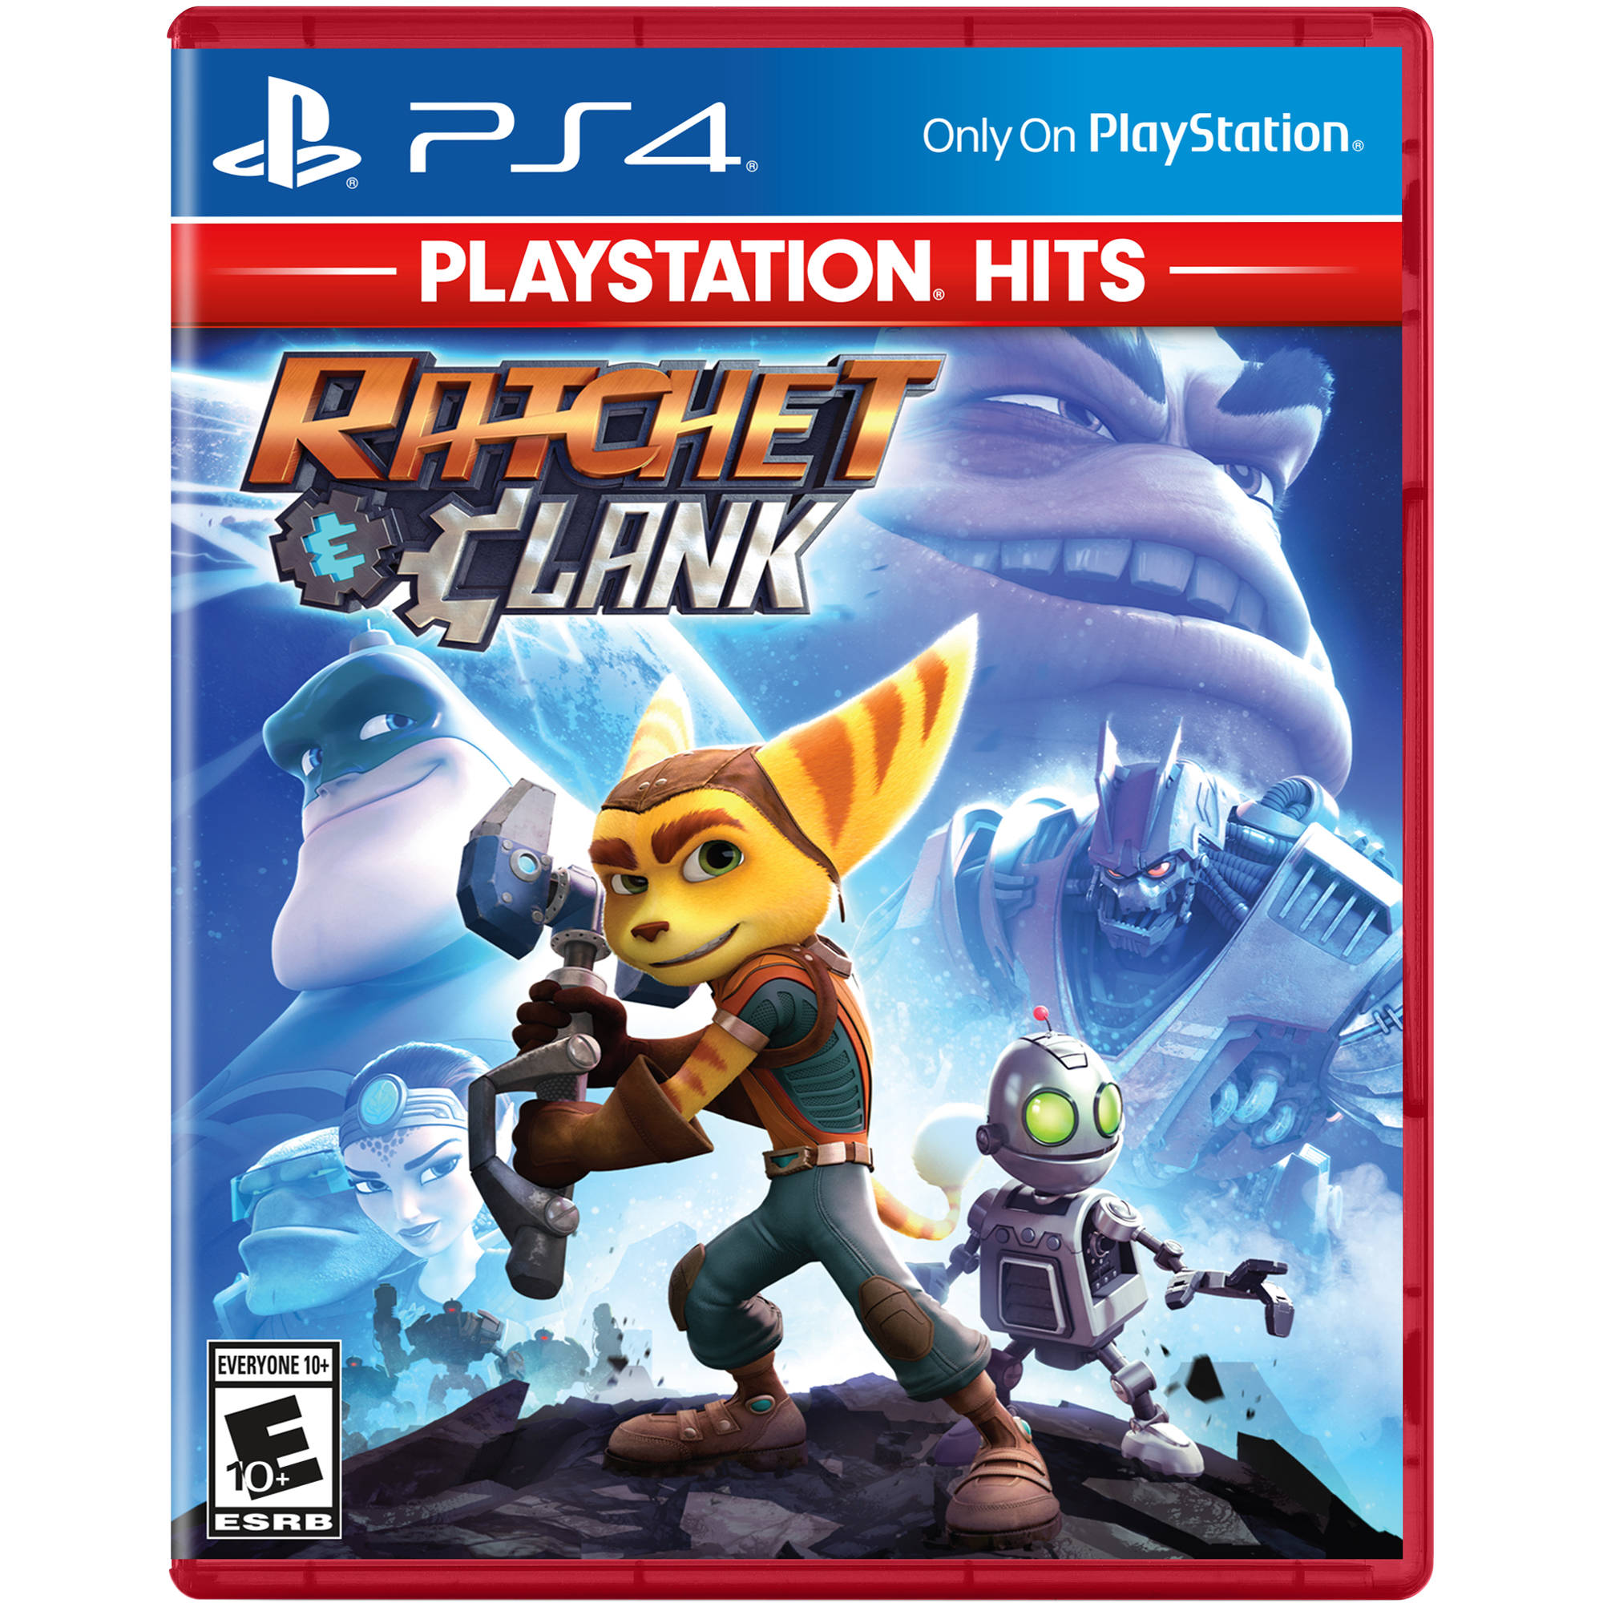
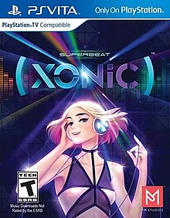
A mash up of several distinguishable franchises… with a twist!
Think of this game as a combination of Sonic the Hedgehog, Ratchet and Clank, and Superbeat: Xonic. All of which are unique, recognizable games.

Slide 9
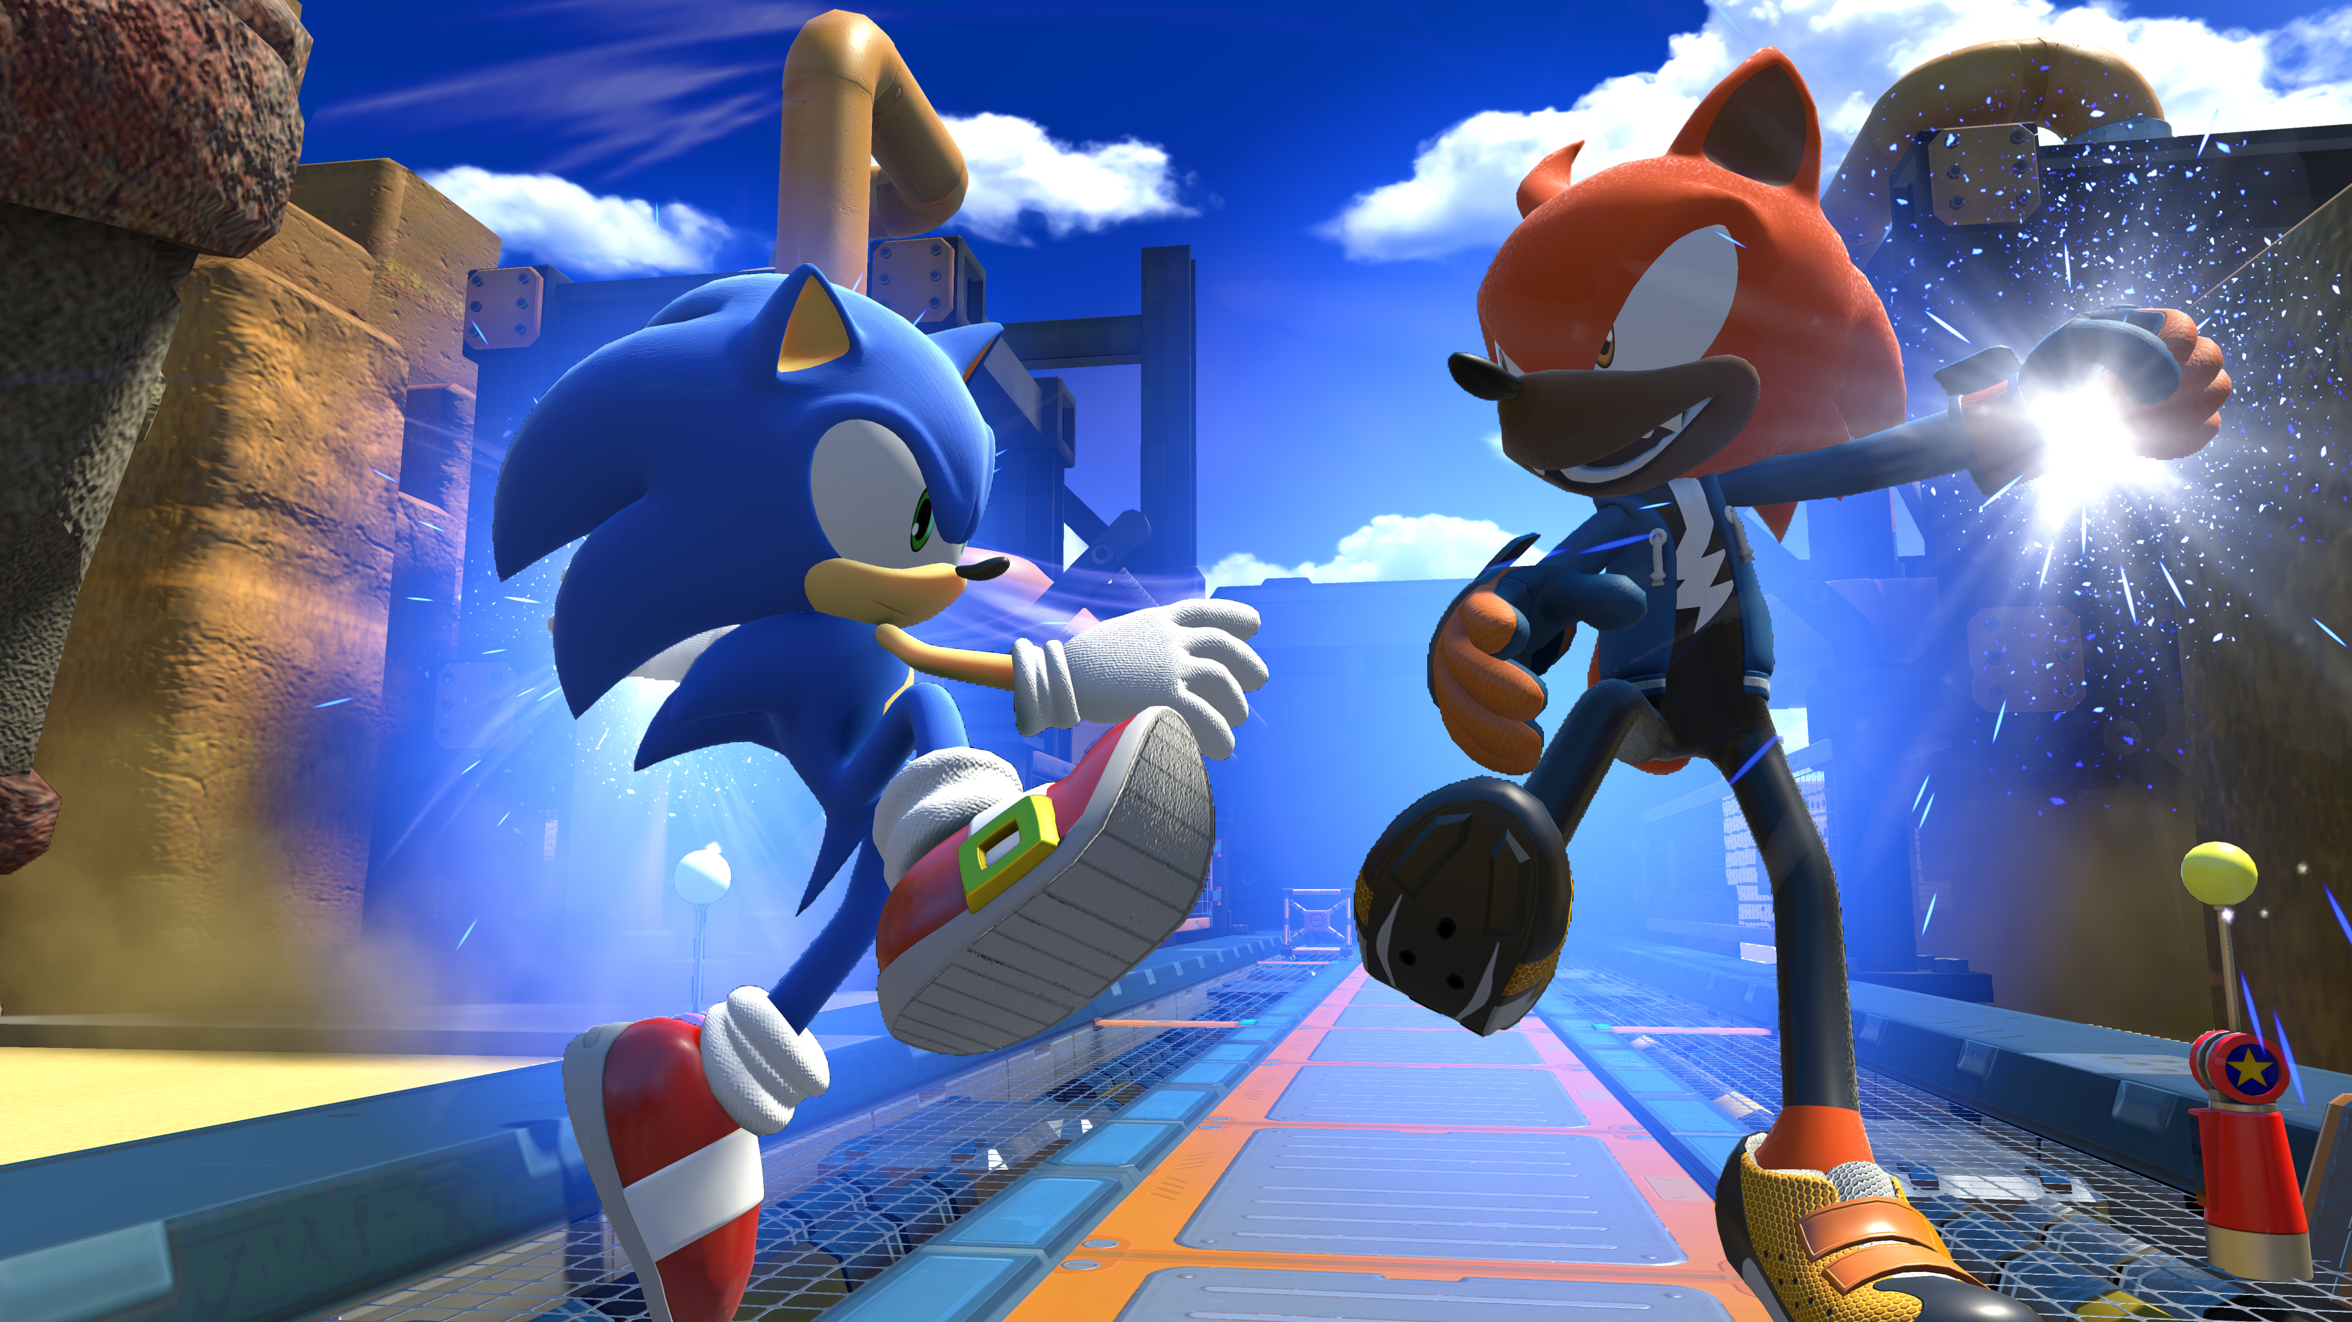
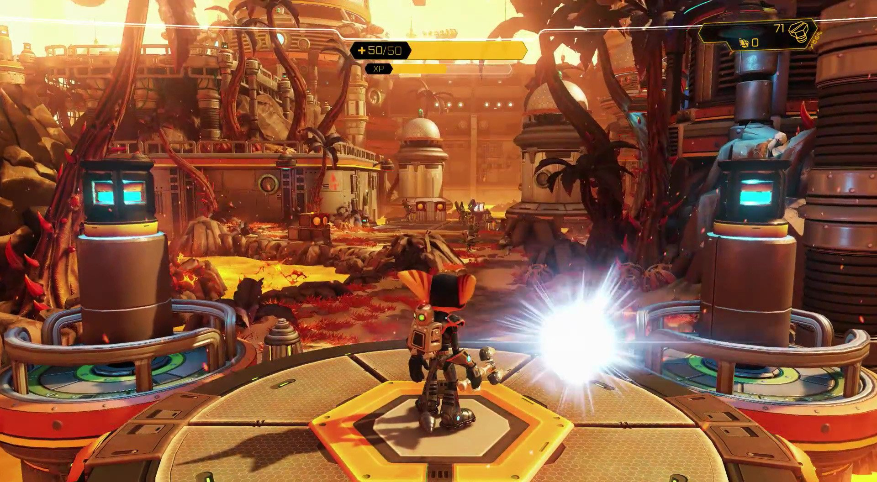
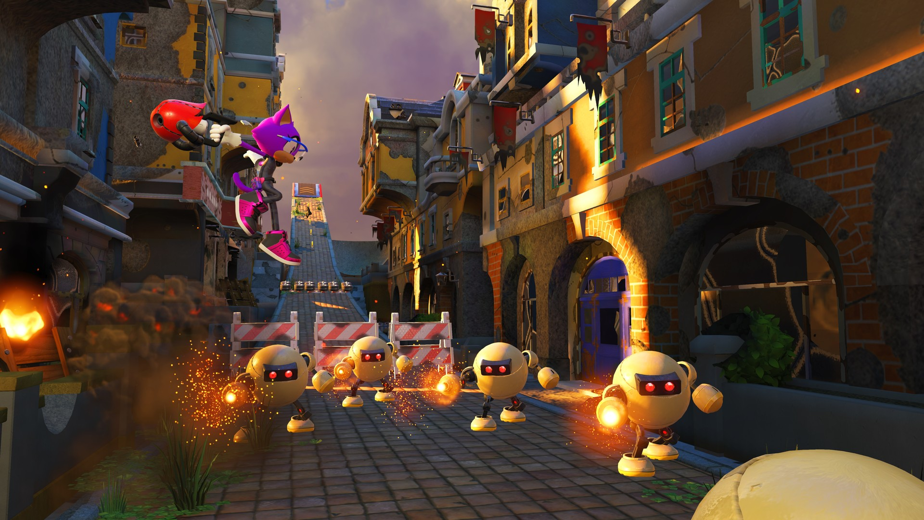
Similar action platforming gameplay and character elements to Sonic the Hedgehog and Ratchet and Clank

Slide 10
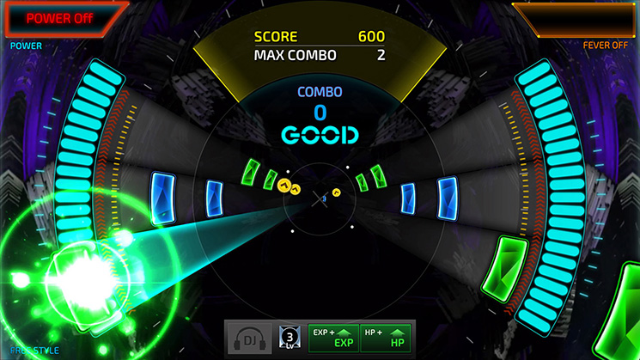
Similar rhythm gameplay elements to Superbeat: Xonic

Slide 11
End goal: defeat mr. drain
Michael wants to live a happy celebrity life and serve as a good role model for other celebrities and aspiring celebrities, but he just can’t do that as long as Mr. Drain is around… or can he?
Help him rescue all of the stolen celebrity voices!

Slide 12
What about other gameplay modes?
Apart from Story Mode, there is Versus Mode, where up to four players perform a song with the goal of obtaining the highest score.
There is also Singing Tournament Mode, where everyone takes turns controlling a character performing a song, and whoever has the highest score advances to the next round. Also has a Custom Character option available, where you can make your own animal celebrity. Also has an Online mode, where you can play with other players not in the same room as you.
In Free Play Mode, up to four players can choose any song from the game they want to perform. This mode becomes available after the halfway point in Story Mode, and new songs are unlocked as the player progresses from here.
In all three of these game modes, every player must choose a different character.

Slide 13
Market and tech specs

Slide 14
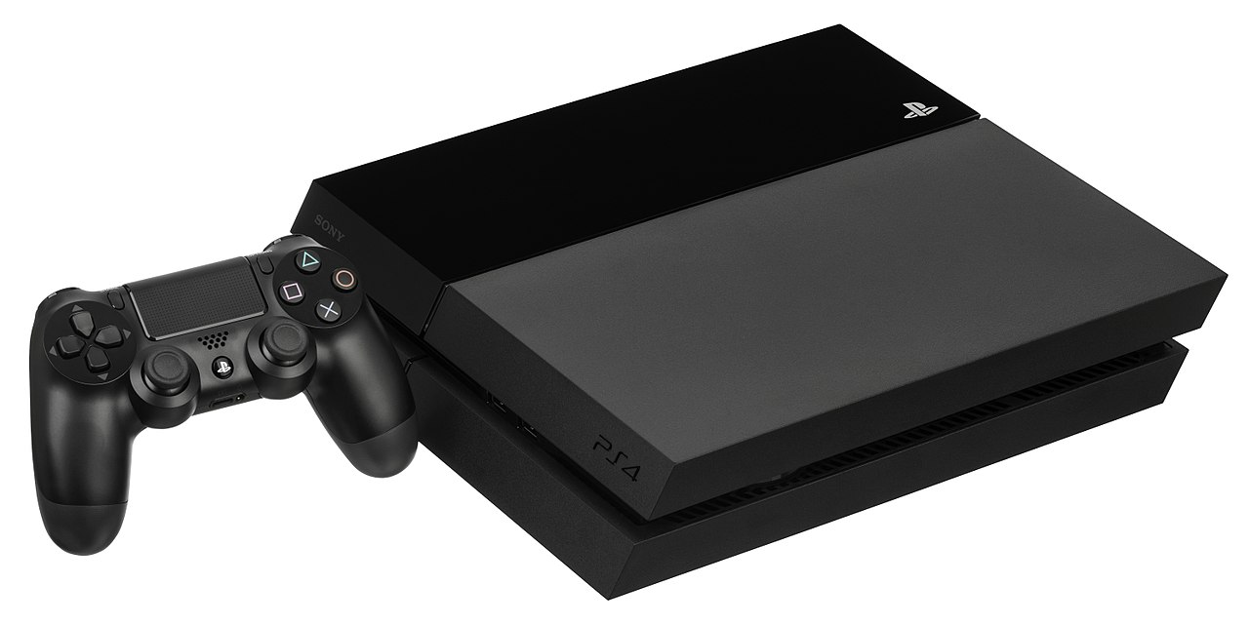
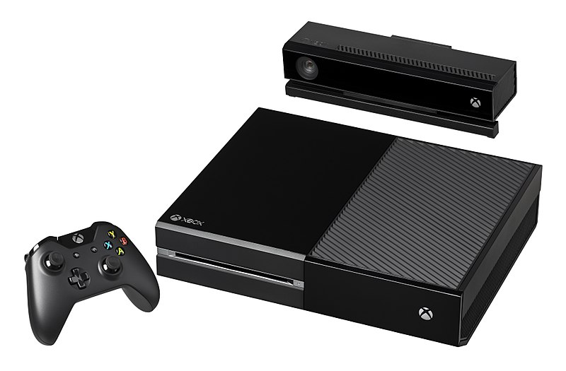
Which platforms will it be released on?
This game would be released on the high-graphic and super powerful PS4 and Xbox One.
Popular consoles in young adult and teen settings
The game would fit in well with these settings

Slide 15
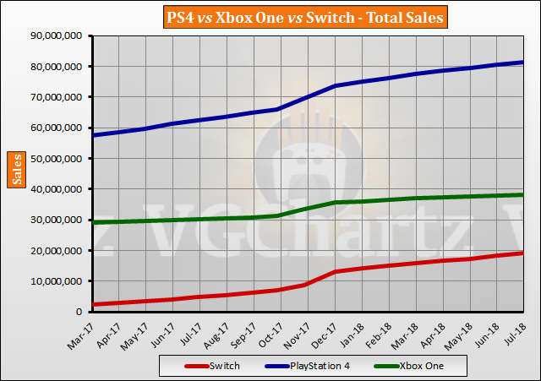
Market info + opportunity
As of September 1, the PS4 had sold a total of 81 million units, while the Xbox One had sold 38 million units
Opportunity to reach and appeal to a wide audience
Both consoles have very high-quality graphics, fitting the vision for this game
Action-adventure games are one of the most popular game genres out there, while music and rhythm video games are enjoyed by many demographics

Slide 16
How long would the development time take?
Total development would take 18-24 months.
This is a standard timeframe for many 3D console games.

Slide 17
Would this game require any licensing?
This game would require licensing for the rights to develop the game using the game engine of choice.
It would also be necessary to obtain the rights to publish the game on the PS4 and Xbox One.

Slide 18
Summary
Rocket Pop is the ultimate music action game like no other.
Help Michael Fleming rescue all of the stolen celebrity voices!
Fight off hordes of enemies in 3D action platformer levels!
Gain the respect of Michael’s rivals in simple rhythm game-style levels!
Upgrade your skills to prepare you for more difficult levels!
Challenge your friends’ rhythm skills with three multiplayer modes!
So, if you want a compelling game experience with easy-to-remember controls, then Rocket Pop is the game for you!

Slide 19
Questions? Feedback?

